Slide 1



PAHICHAAN
Work - Achieve - Share
Notes:
The role of engineering is one of the key influences that shapes your society. Engineers don’t just work with machines but also use their creativities to provide innovations and inventions that shape our society and improve the way we live and work.
And as a future software engineer, I came here with the proposal of Project “Pahichaan” with the team …

Slide 2
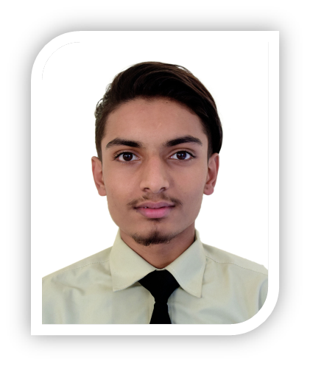
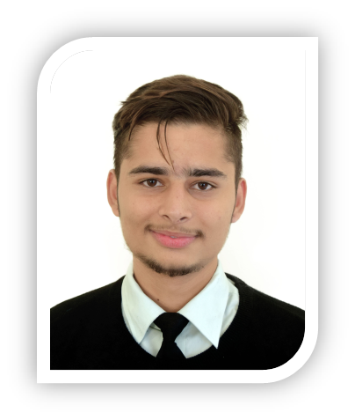
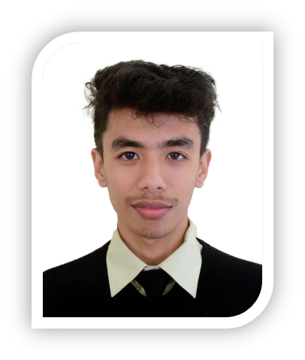

Meet Our Team
Arjun Adhikari
Samir Poudel
Sunil Gautam
Er. Nishal Gurung
Project Leader
Member
Member
Supervisor

Slide 3
INTRODUCTION
a web application which enables the users to showcase their recognition status.
Users can connect to each other.
Users can react to the posts offered by their connections.
Text messaging with connections.
Notes:
a web application which enables the users to showcase their recognition status.
Users can connect to each other.
Users can react to the posts offered by their connections.
Text messaging with connections.

Slide 4
CURRENT SCENARIO
The traditional method of sharing self recognition status was a bit tedious and couldn’t get broad recognition in a short period of time.
We had to share such information in-person and broad advertisement was not possible.
Not all social sites are purely based on the recognition status that we are focusing on.
Notes:
The traditional method of sharing self recognition status was a bit tedious and couldn’t get broad recognition in a short period of time.
We had to share such information in-person and broad advertisement was not possible.
Not all social sites are purely based on the recognition status that we are focusing on.

Slide 5
OBJECTIVES
• To post pictures of honors, achievements, and certificates allowing the users to showcase their recognition.
• To communicate with the connections via text messaging.
• To notify the users if events like reaction on posts, new connections as well as suspension and deletion of accounts for inappropriate behavior on the network.
Notes:
• To post pictures of honors, achievements, and certificates allowing the users to showcase their recognition.
• To communicate with the connections via text messaging.
• To notify the users if events like reaction on posts, new connections as well as suspension and deletion of accounts for inappropriate behavior on the network.

Slide 6
FEATURES
Sharing medias related to Recognition status
Connections to other users
Direct Conversation to the Connections.
Notes:
Sharing medias related to Recognition status
Connections to other users
Direct Conversation to the Connections.

Slide 7
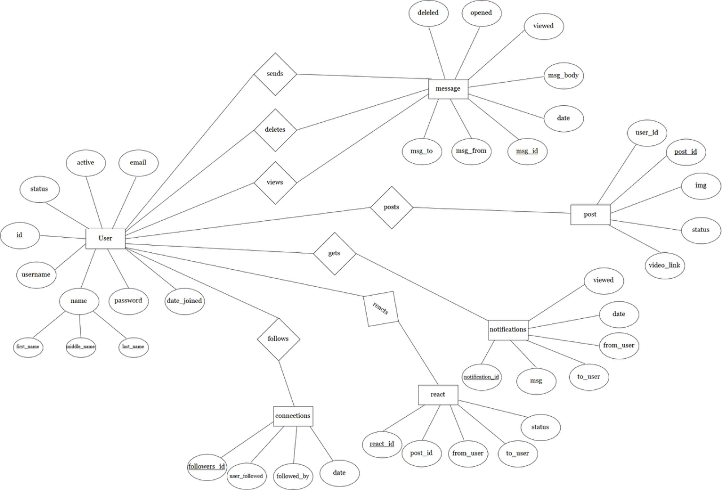
ER-DIAGRAM

Slide 8
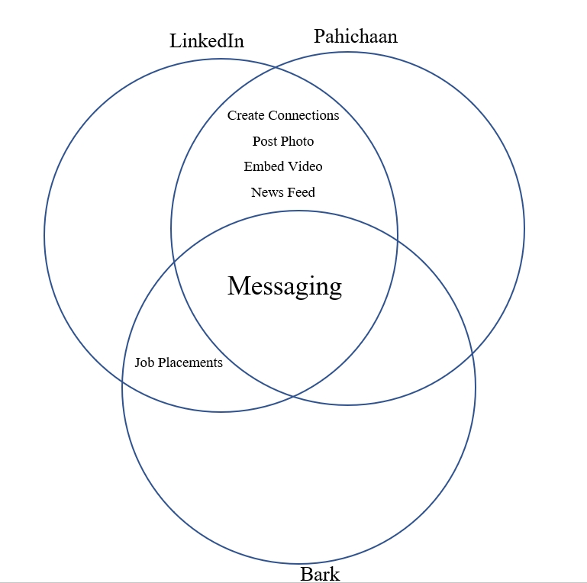
LITERATURE REVIEW
LinkedIn
Pahichaan⁺
Create Connection
Post Photo
Embed Video
Newsfeed
Messaging
Job Placement
Create Connection
Post Photo
Embed Video
Newsfeed
Messaging
Job Placement
Bark
Create Connection
Post Photo
Embed Video
Newsfeed
Messaging
Job Placement
Feature Available
Feature Unavailable

Slide 9
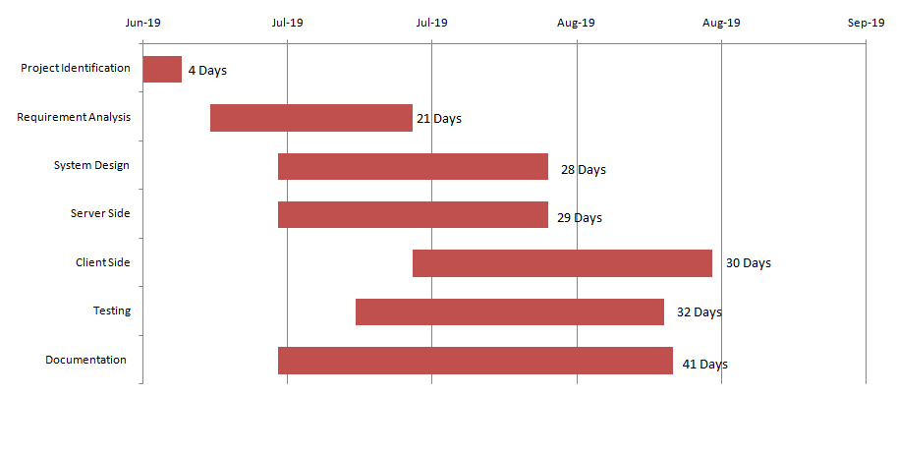
TIMELINE

Slide 10
Any Queries?

